Slide 1





Long Video Understanding: Architecture and Evaluation
Speaker: Wenhu Chen

Slide 2
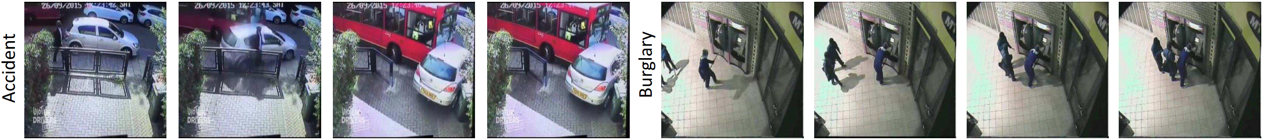
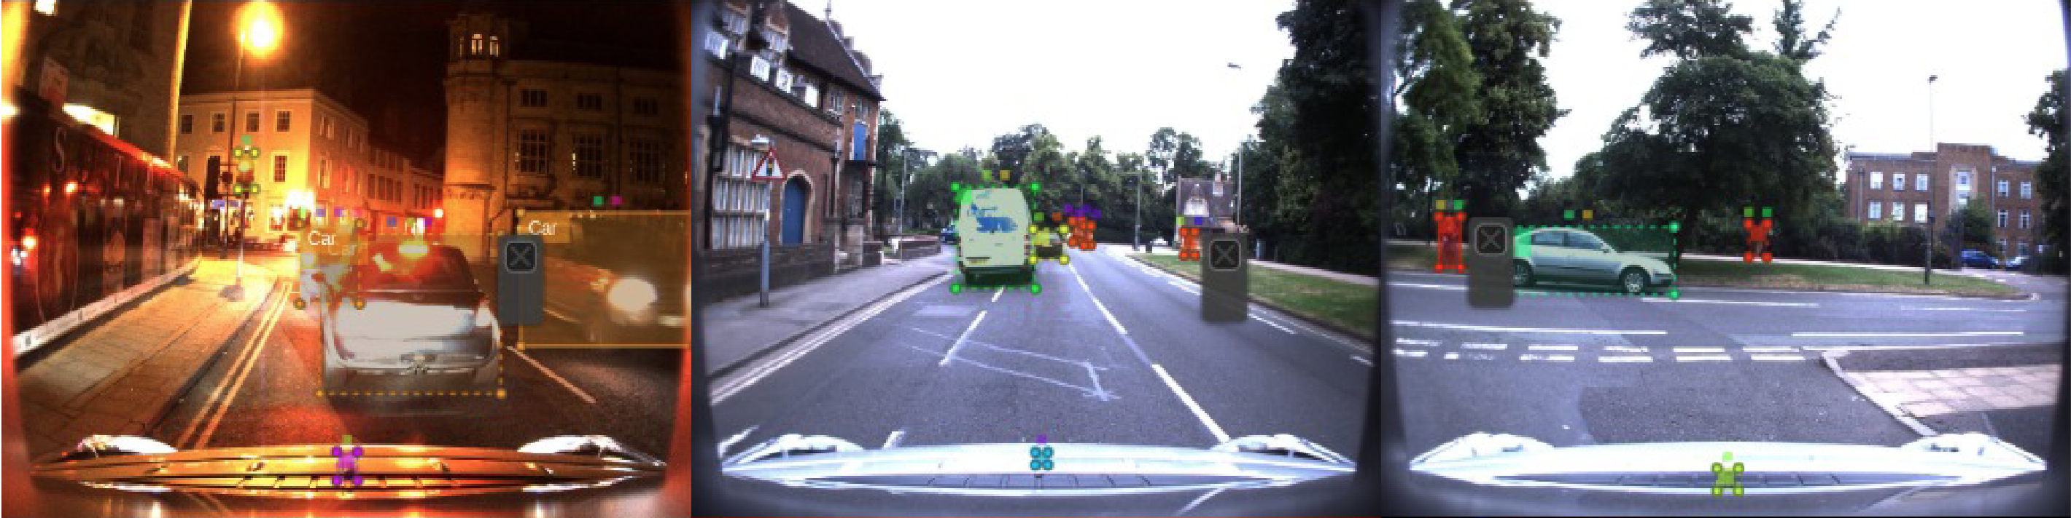
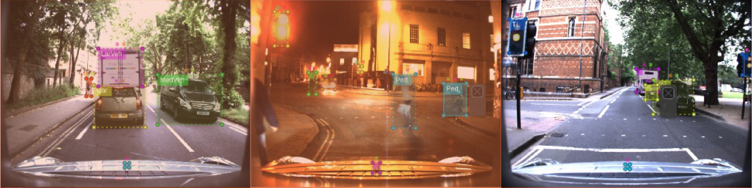
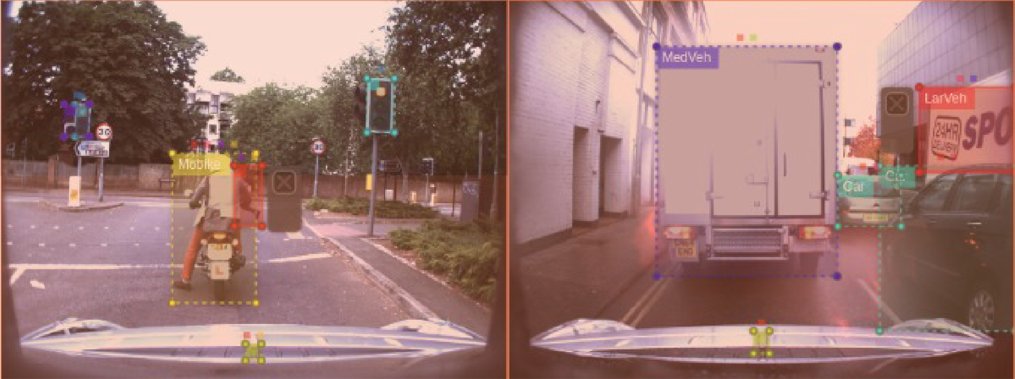
Background
Long Video Understanding: Diverse Use Cases
Video Surveillance / Anomaly Detection
Autonomous Driving
Sultani, Waqas, Chen Chen, and Mubarak Shah. "Real-world anomaly detection in surveillance videos." Proceedings of the IEEE conference on computer vision and pattern recognition. 2018.
Singh, Gurkirt, et al. "Road: The road event awareness dataset for autonomous driving." IEEE transactions on pattern analysis and machine intelligence 45.1 (2022): 1036-1054.

Slide 3
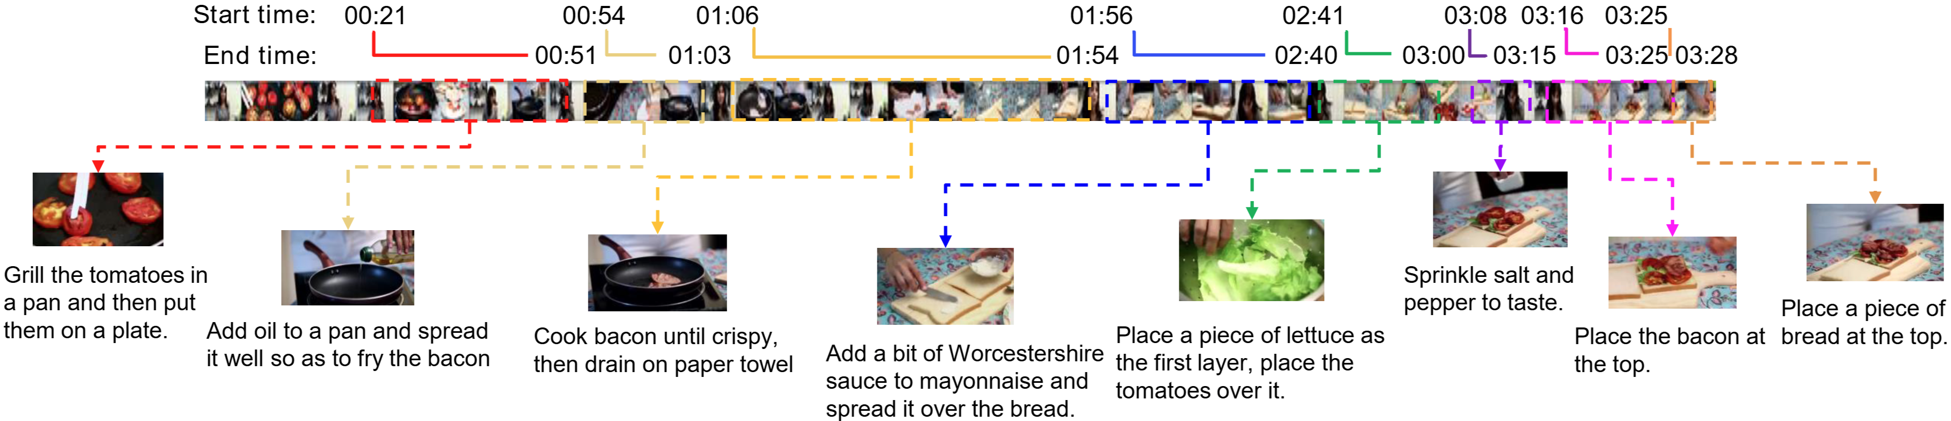
Background
Long Video Understanding: Diverse Use Cases
Video Surveillance / Anomaly Detection
Content Summarization / Event Detection in Instructional Videos
Usually, these tasks cannot be solved by only looking at a few frames
Dense sampling (e.g. sampling several hundreds of frames) is required for the task.
Zhou, Luowei, Chenliang Xu, and Jason Corso. "Towards automatic learning of procedures from web instructional videos." Proceedings of the AAAI conference on artificial intelligence. Vol. 32. No. 1. 2018.

Slide 4
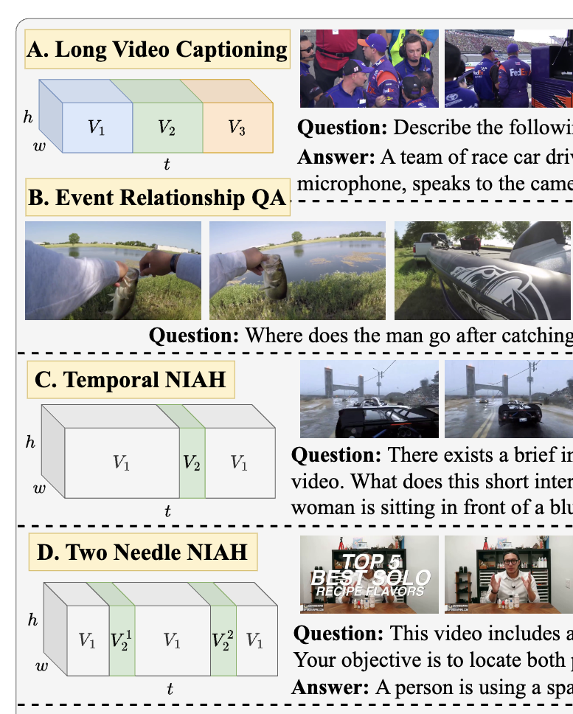
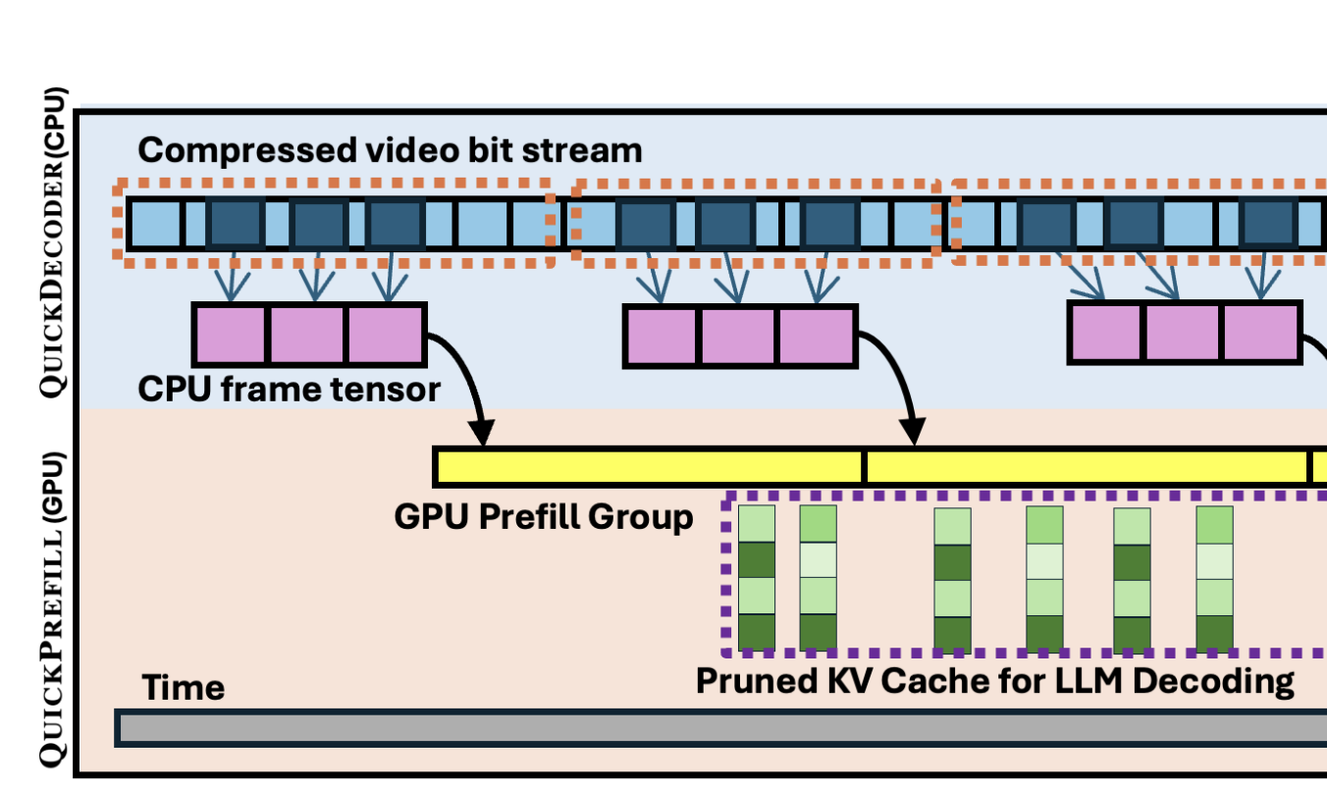
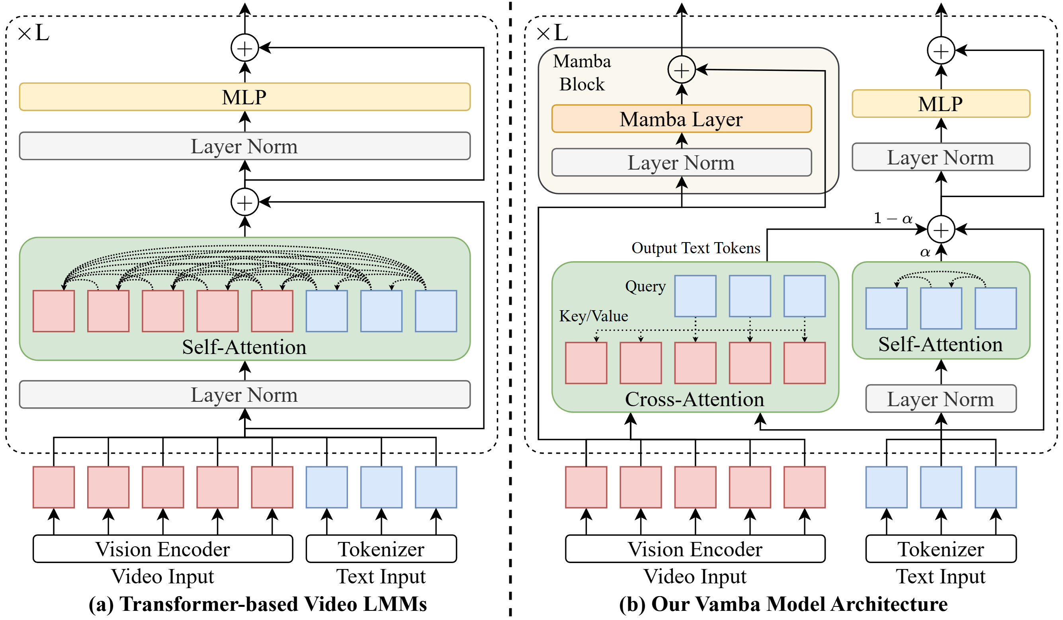
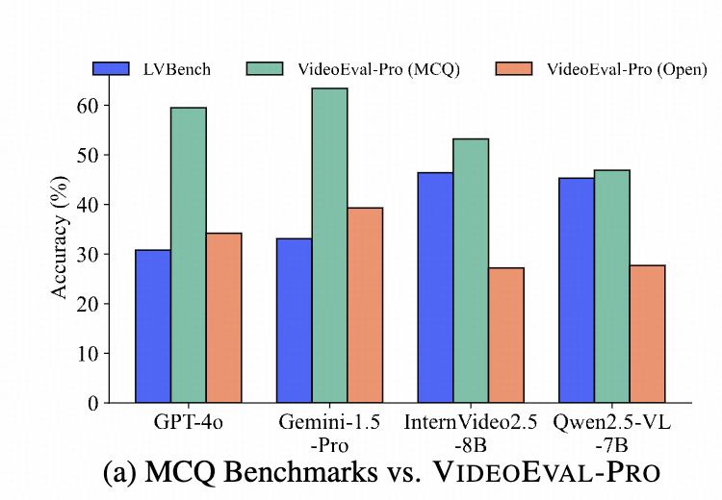
Long-Video Understanding
Training Data:
*Vista
Ren et al. 2024
Infrastructure:
*QuickVideo
Schneider et al. 2025
Long Video
Model:
*Vamba
Ren et al. 2025
Evaluation:
*VideoEval-Pro
Ma et al. 2025

Slide 5
Vamba: Understanding Hour-Long Videos with Hybrid Mamba-Transformers
Weiming Ren, Wentao Ma, Huan Yang, Cong Wei, Ge Zhang, Wenhu Chen

Slide 6
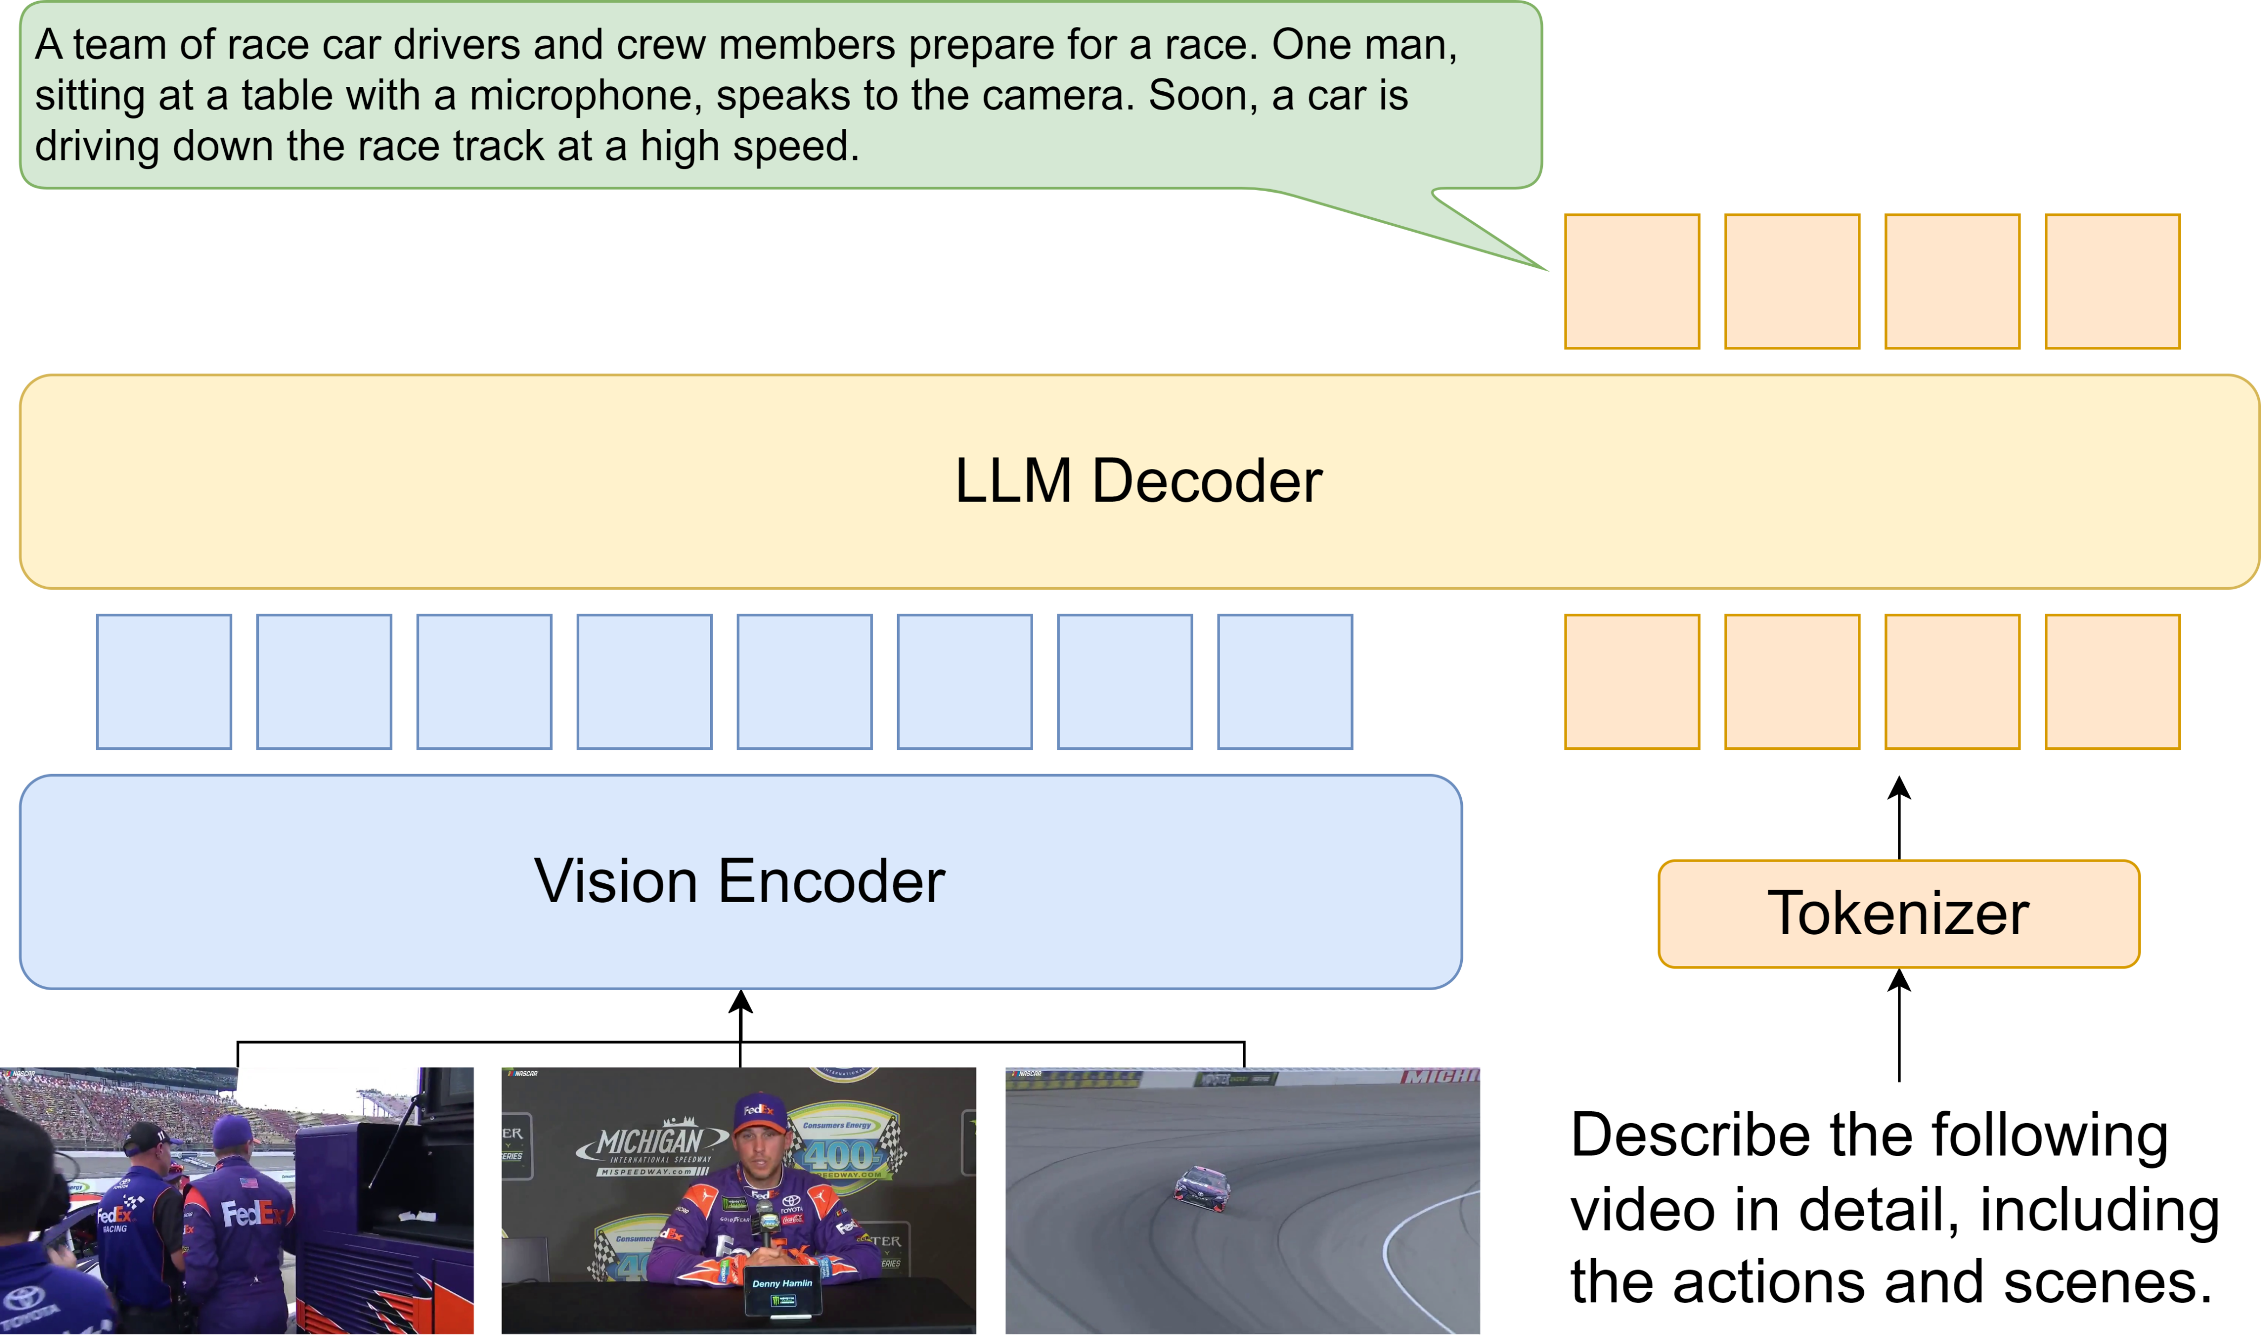
Background
Large Multimodal Models (LMMs) for Long Video Understanding
Most powerful & popular LMMs are based on transformers.
E.g. Qwen2.5-VL, InternVL3, LLaVA-OneVision, etc
Are they perfect?

Slide 7
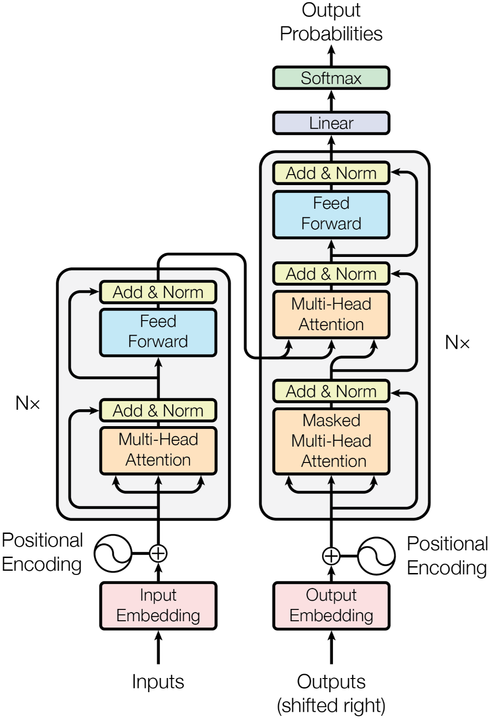
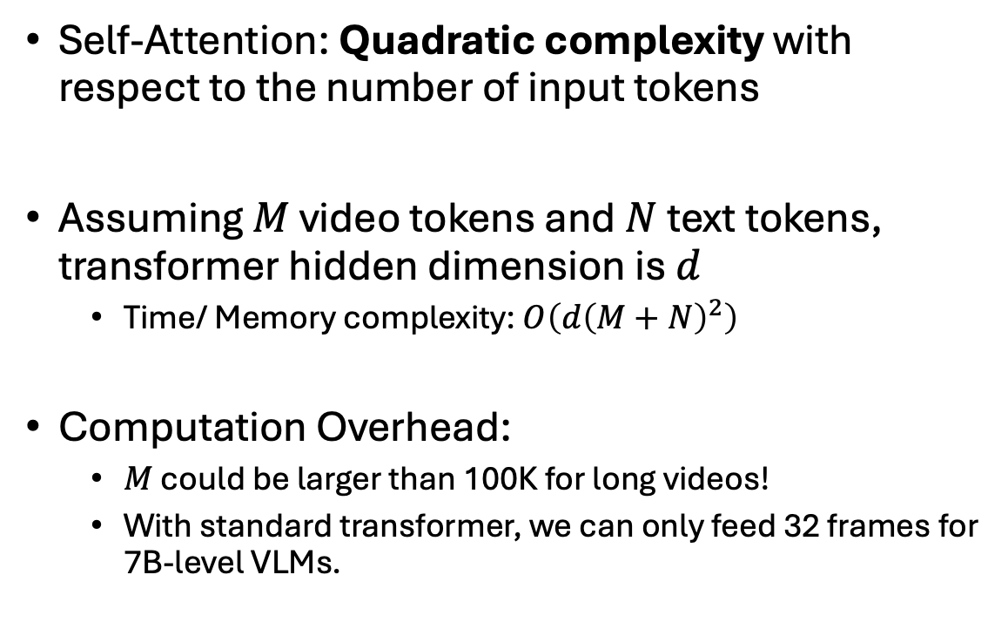
Dilemma of Transformer Models
Self-Attention: Quadratic complexity with respect to the number of input tokens
Assuming $M$ video tokens and $N$ text tokens, transformer hidden dimension is $d$
Time/ Memory complexity: $O\left({d\left(M+N\right)}^{2}\right)$
Computation Overhead:
$M$ could be larger than 100K for long videos!
With standard transformer, we can only feed 32 frames for 7B-level VLMs.
Vaswani, Ashish, et al. "Attention is all you need." Advances in neural information processing systems 30 (2017).

Slide 8
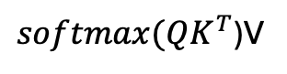
Token Compression 1: Q-former
Vision Language Models
$softmax(QK^{T}$)V
Fixed dim
Long Video tokens
Representative Models:
VideoChat
Video-CCAM
Video-Llama
Li, KunChang, et al. "Videochat: Chat-centric video understanding." arXiv preprint arXiv:2305.06355 (2023).

Slide 9
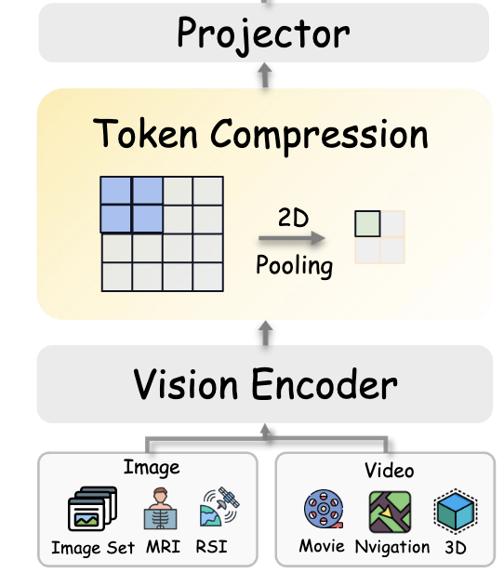
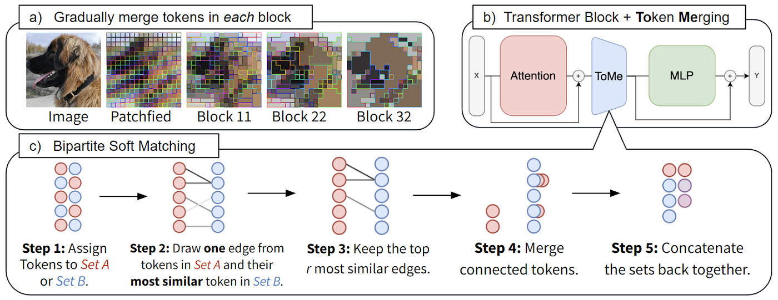
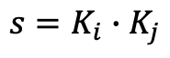
Token Compression 2: Token Pooling
$$s=K_{i}∙K_{j}$$
Representative Models:
Orxy-1.5
InternVideo2.5
Long-Llava
Wang, Xidong, et al. "LongLLaVA: Scaling Multi-modal LLMs to 1000 Images Efficiently via a Hybrid Architecture." arXiv preprint arXiv:2409.02889 (2024).

Slide 10
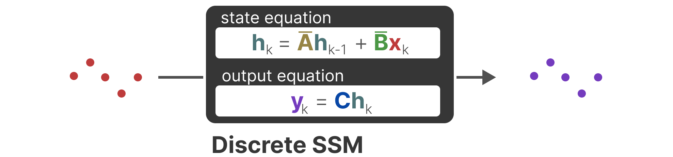
S4: Linear-Time Sequence Modelling
Structured State Space Models are linear time invariant sequence models
Linear time complexity
Constant memory complexity
Designed to handle long-context tasks
Input
(Sequence)
Output
(Sequence)
A Visual Guide to Mamba and State Space Models. https://newsletter.maartengrootendorst.com/p/a-visual-guide-to-mamba-and-state

Slide 11
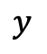
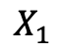
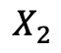
Limitations of S4
$$X_{1}$$
B
h
C
$$y$$
Different input
Same matrix
A
Different input
Same matrix
$$X_{2}$$
B
h
C
$$y$$
A
S4 processes each token equally with the same function!

Slide 12
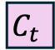
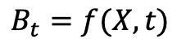
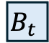
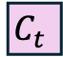
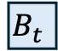
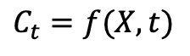
Mamba: Selective Scan
$$B_{t}=f(X, t)$$
$$C_{t}=f(X, t)$$
$$X_{1}$$
$$B_{t}$$
h
$$C_{t}$$
$$y$$
Different input
Dfferent matrix
A
Different input
Different matrix
$$X_{2}$$
$$B_{t}$$
h
$$C_{t}$$
$$y$$
A
S4 processes each token equally with the same function!

Slide 13
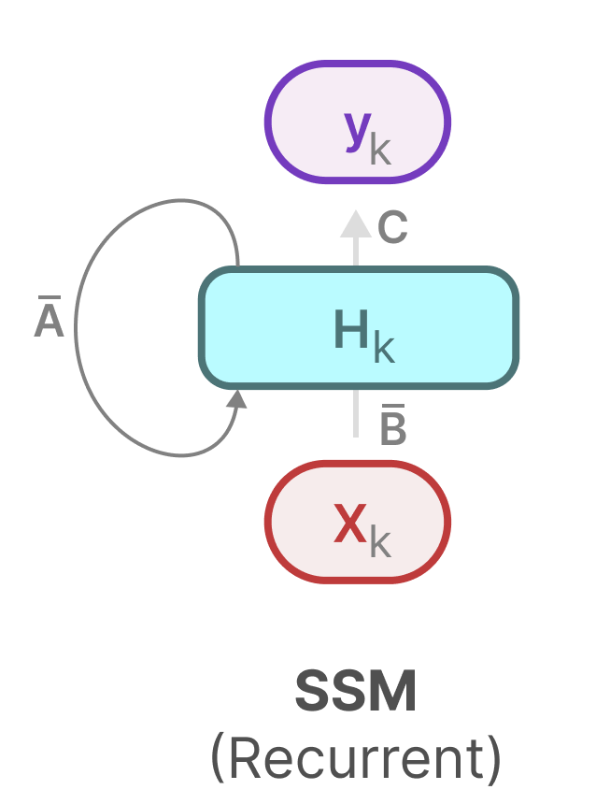
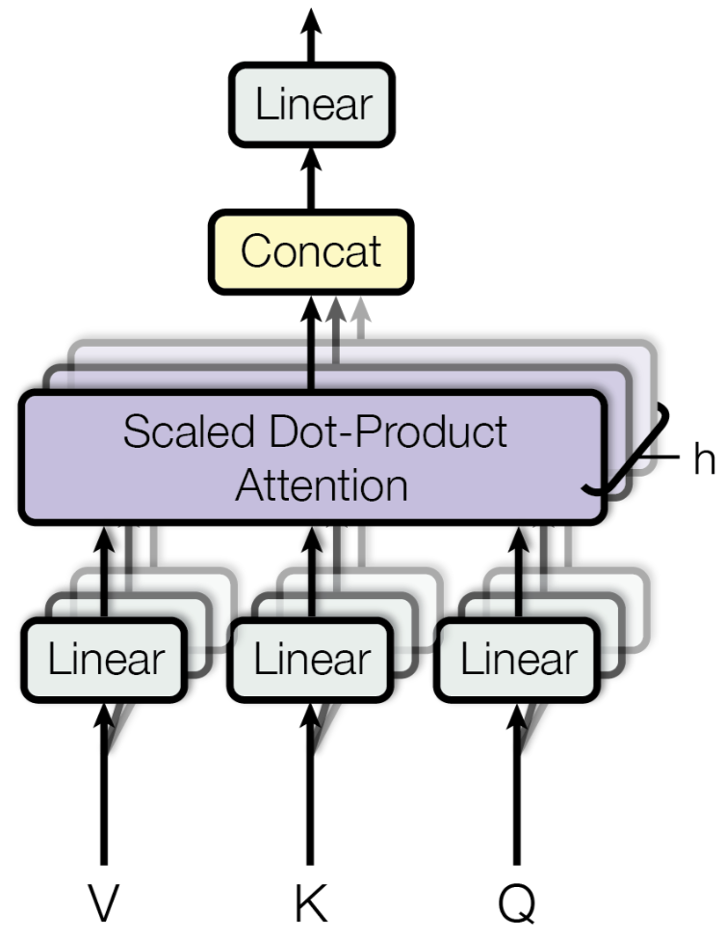
Hybrid Mamba-Transformer Models
Mamba
Transformers
Efficient, Linear complexity.
Suitable at handling long-context data
…But hasn’t beat transformer-based LLM/LMMs
Proven to be powerful at recalling.
…Yet suffers from quadratic complexity
How about we use Mamba to handle the long sequence of video tokens?
We can still let transformers to handle the text (which is not too long)!

Slide 14
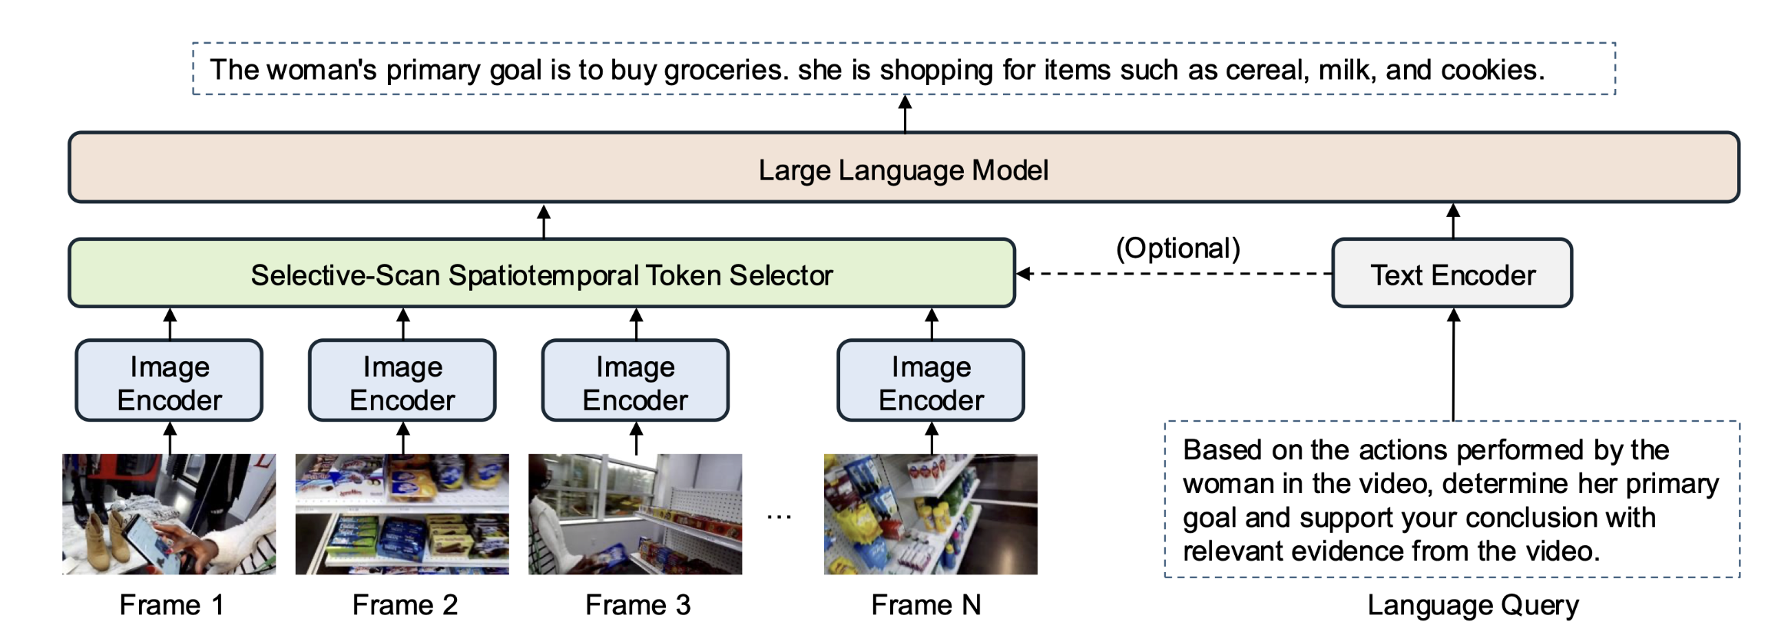
Existing Hybrid Mamba-Transformers: BIMBA
Islam, Md Mohaiminul, et al. "Bimba: Selective-scan compression for long-range video question answering." Proceedings of the Computer Vision and Pattern Recognition Conference. 2025.

Slide 15
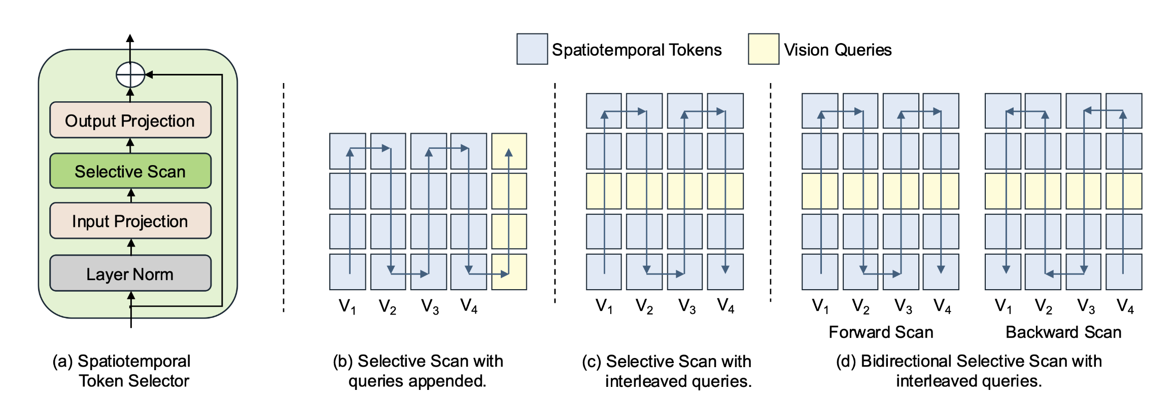
Existing Hybrid Mamba-Transformers: BIMBA

Slide 16
Existing Hybrid Mamba-Transformers: BIMBA

Slide 17
Existing Hybrid Mamba-Transformers: BIMBA

Slide 18
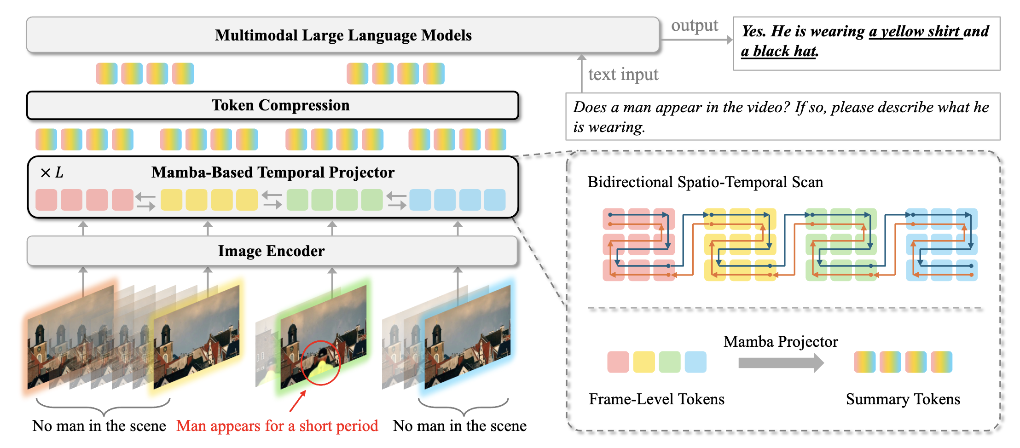
Existing Hybrid Mamba-Transformers: STORM
Jiang, Jindong, et al. "Token-efficient long video understanding for multimodal llms." arXiv preprint arXiv:2503.04130 (2025).

Slide 19
Existing Hybrid Mamba-Transformers: STORM

Slide 20
Existing Hybrid Mamba-Transformers: STORM

Slide 21
Existing Hybrid Mamba-Transformers: STORM

Slide 22

Token Compression 3: Selective Scan
Mamba serves as a token compression mechanism
Can we avoid token compression and naturally support long videos?

Slide 23
Vamba: Hybrid Model for Long Sequence
Mamba blocks for video tokens
Transformer Layers for text tokens

Slide 24
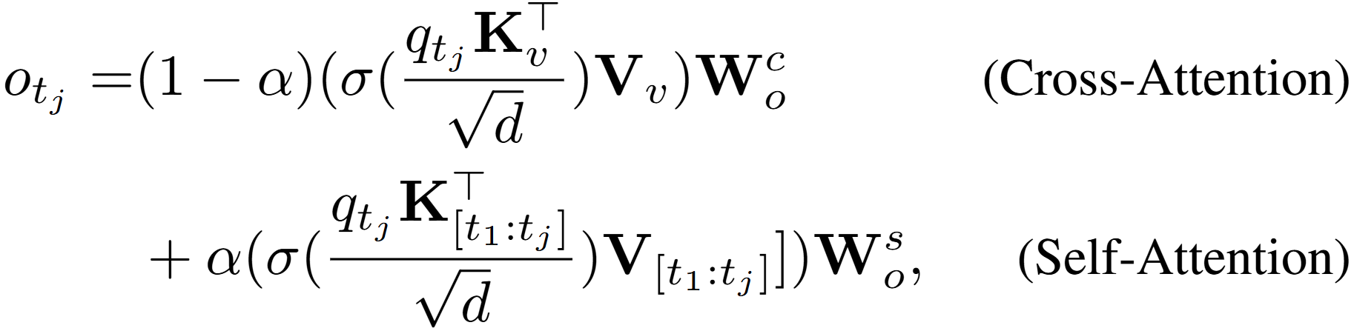
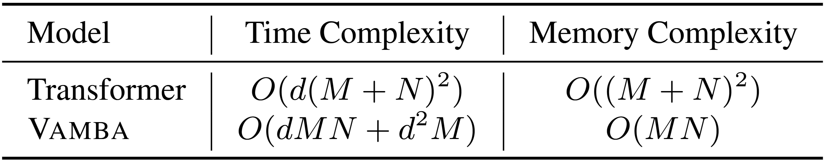
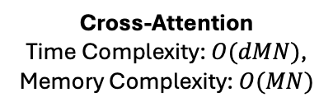
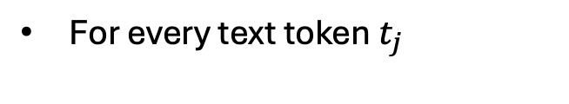
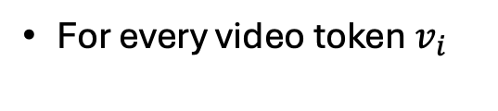

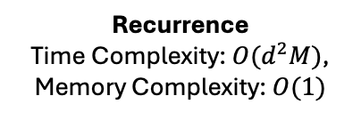
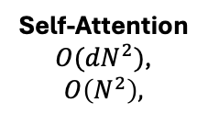
Vamba Update Rule
For every video token $v_{i}$
For every text token $t_{j}$
Recurrence
Time Complexity: $O(d^{2}M)$,
Memory Complexity: $O(1)$
Cross-Attention
Time Complexity: $O(dMN)$,
Memory Complexity: $O(MN)$
Self-Attention
$O({dN}^{2})$,
$$O\left(N^{2}\right),$$
Given $M≫N$, Vamba has linear complexity!

Slide 25
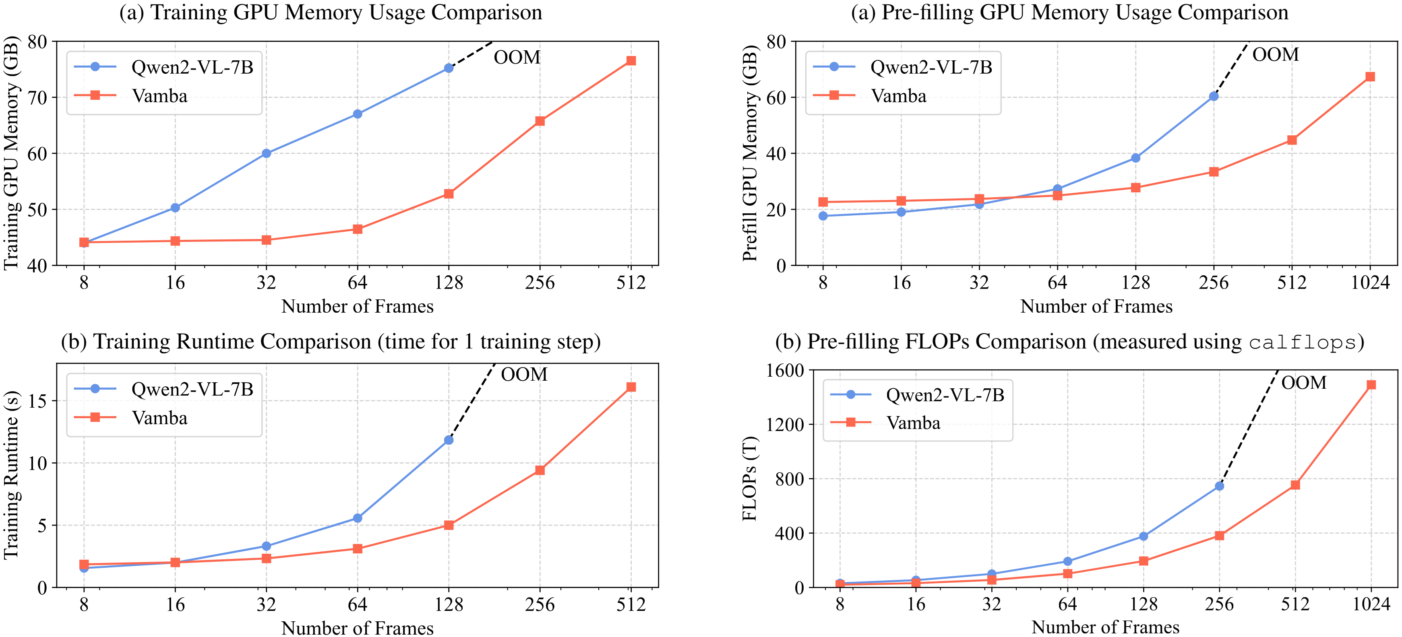
Runtime Efficiency Analysis

Slide 26
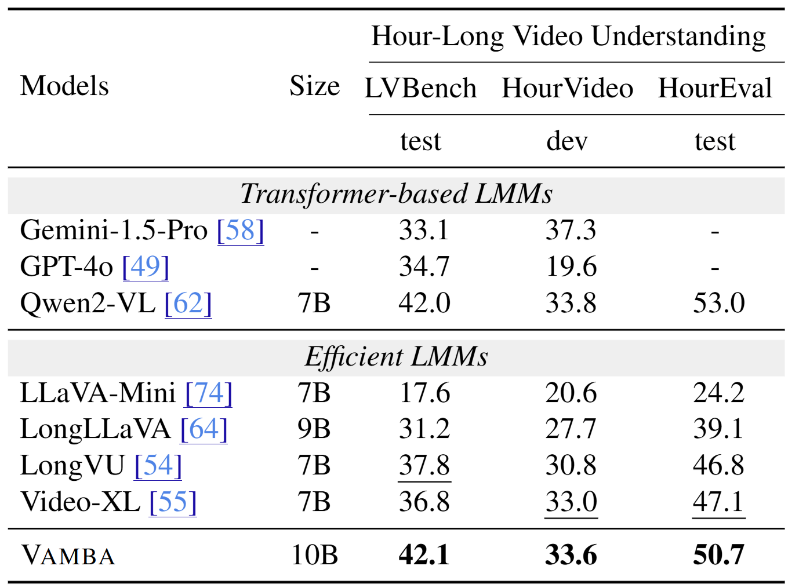
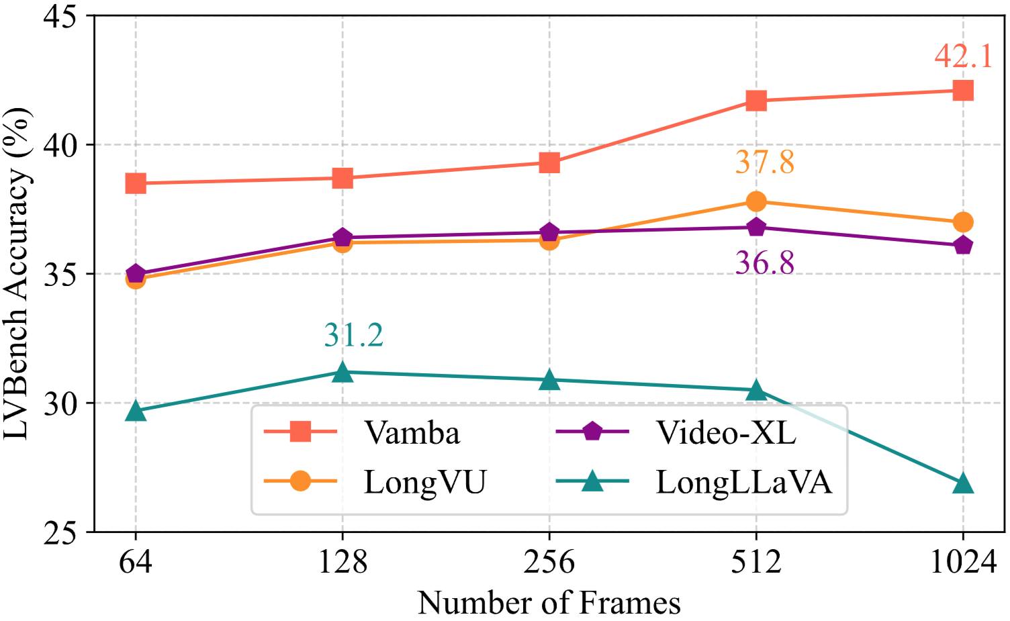
Long Video Understanding Results
Average Length ~ 1 hour

Slide 27
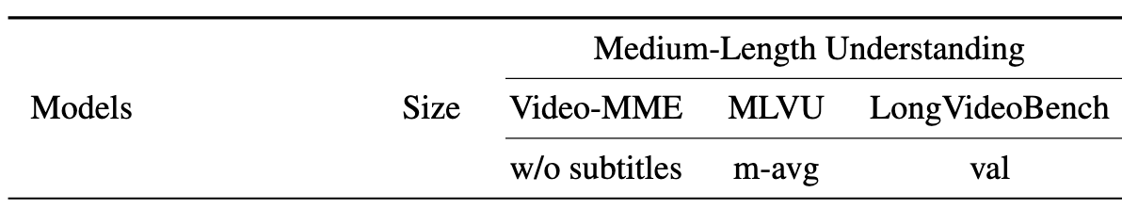
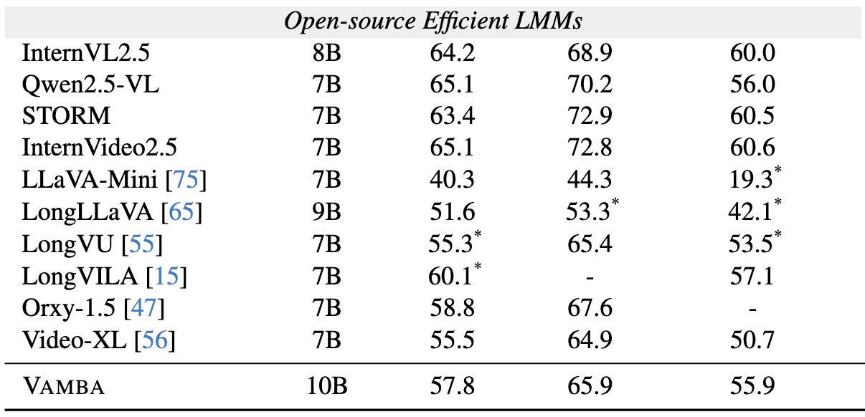
Medium Video Understanding Results
On medium length video
understanding tasks,
Vamba is still behind the token
compression based methods.
Average Length > 5 mins

Slide 28
VideoEval-Pro: Robust and Realistic Long Video Understanding Evaluation
Wentao Ma, Weiming Ren, Yiming Jia, Zhuofeng Li, Ping Nie, Ge Zhang, Wenhu Chen

Slide 29
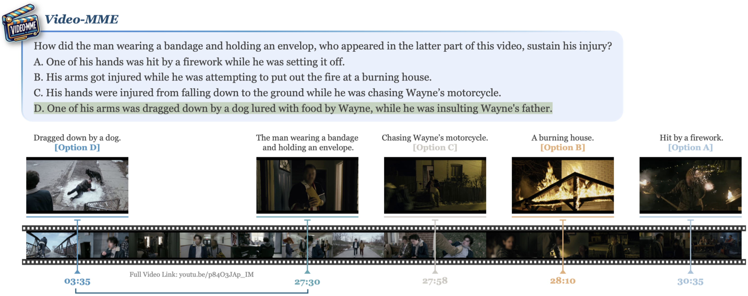
Existing Long-Video Benchmarks
Long Video Understanding Benchmarks: Video-MME, MLVU, LVBench, etc
Fu, Chaoyou, et al. "Video-mme: The first-ever comprehensive evaluation benchmark of multi-modal llms in video analysis." Proceedings of the Computer Vision and Pattern Recognition Conference. 2025.

Slide 30
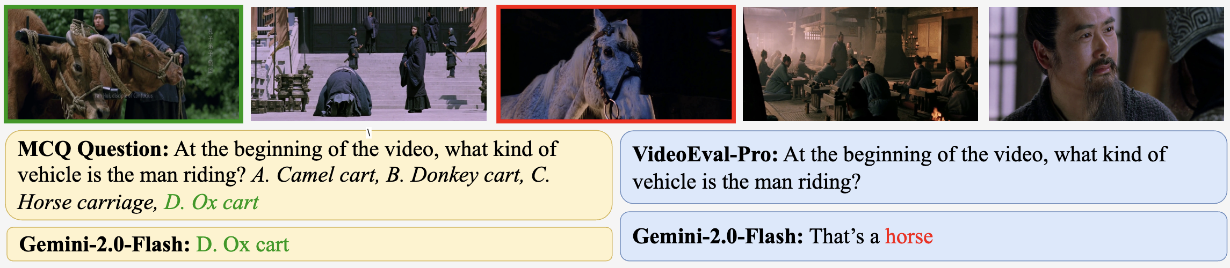
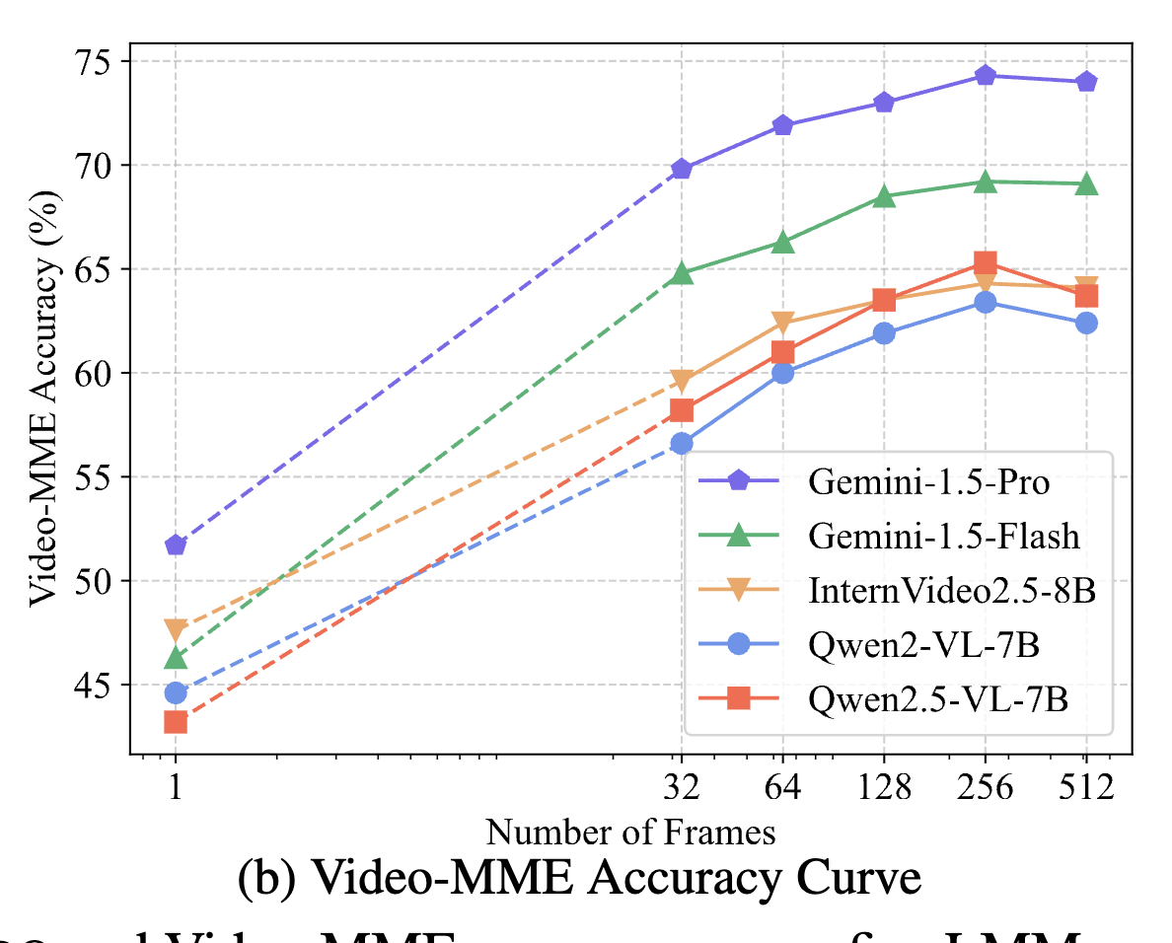
A Sober Look At Long Video Benchmarks
Multiple-choice (MCQ)
Model performances on current benchmarks saturate or even decline as the number of input frames increases – Counterintuitive observation!
Strong Prior

Slide 31
A Sober Look At Long Video Benchmarks
Based on these observations, we have two central questions:
Do existing long video benchmarks faithfully reflect models’ real capacity to understand long video content?
Do the gains reported by newer models genuinely translate into stronger long video comprehension capability, or are they illusional?

Slide 32
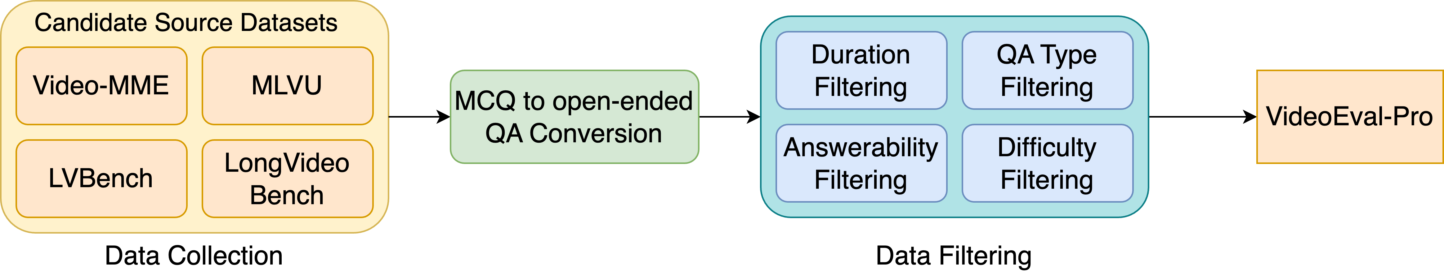
Building Robust and Realistic Benchmarks
Step 1: We collect MCQ problems from existing long video understanding benchmarks and convert them into open-ended questions with short answer.
Step 2: We filter the questions which can be answered by simply looking at no frame or 1 frame. This reduces the prior-based questions.

Slide 33
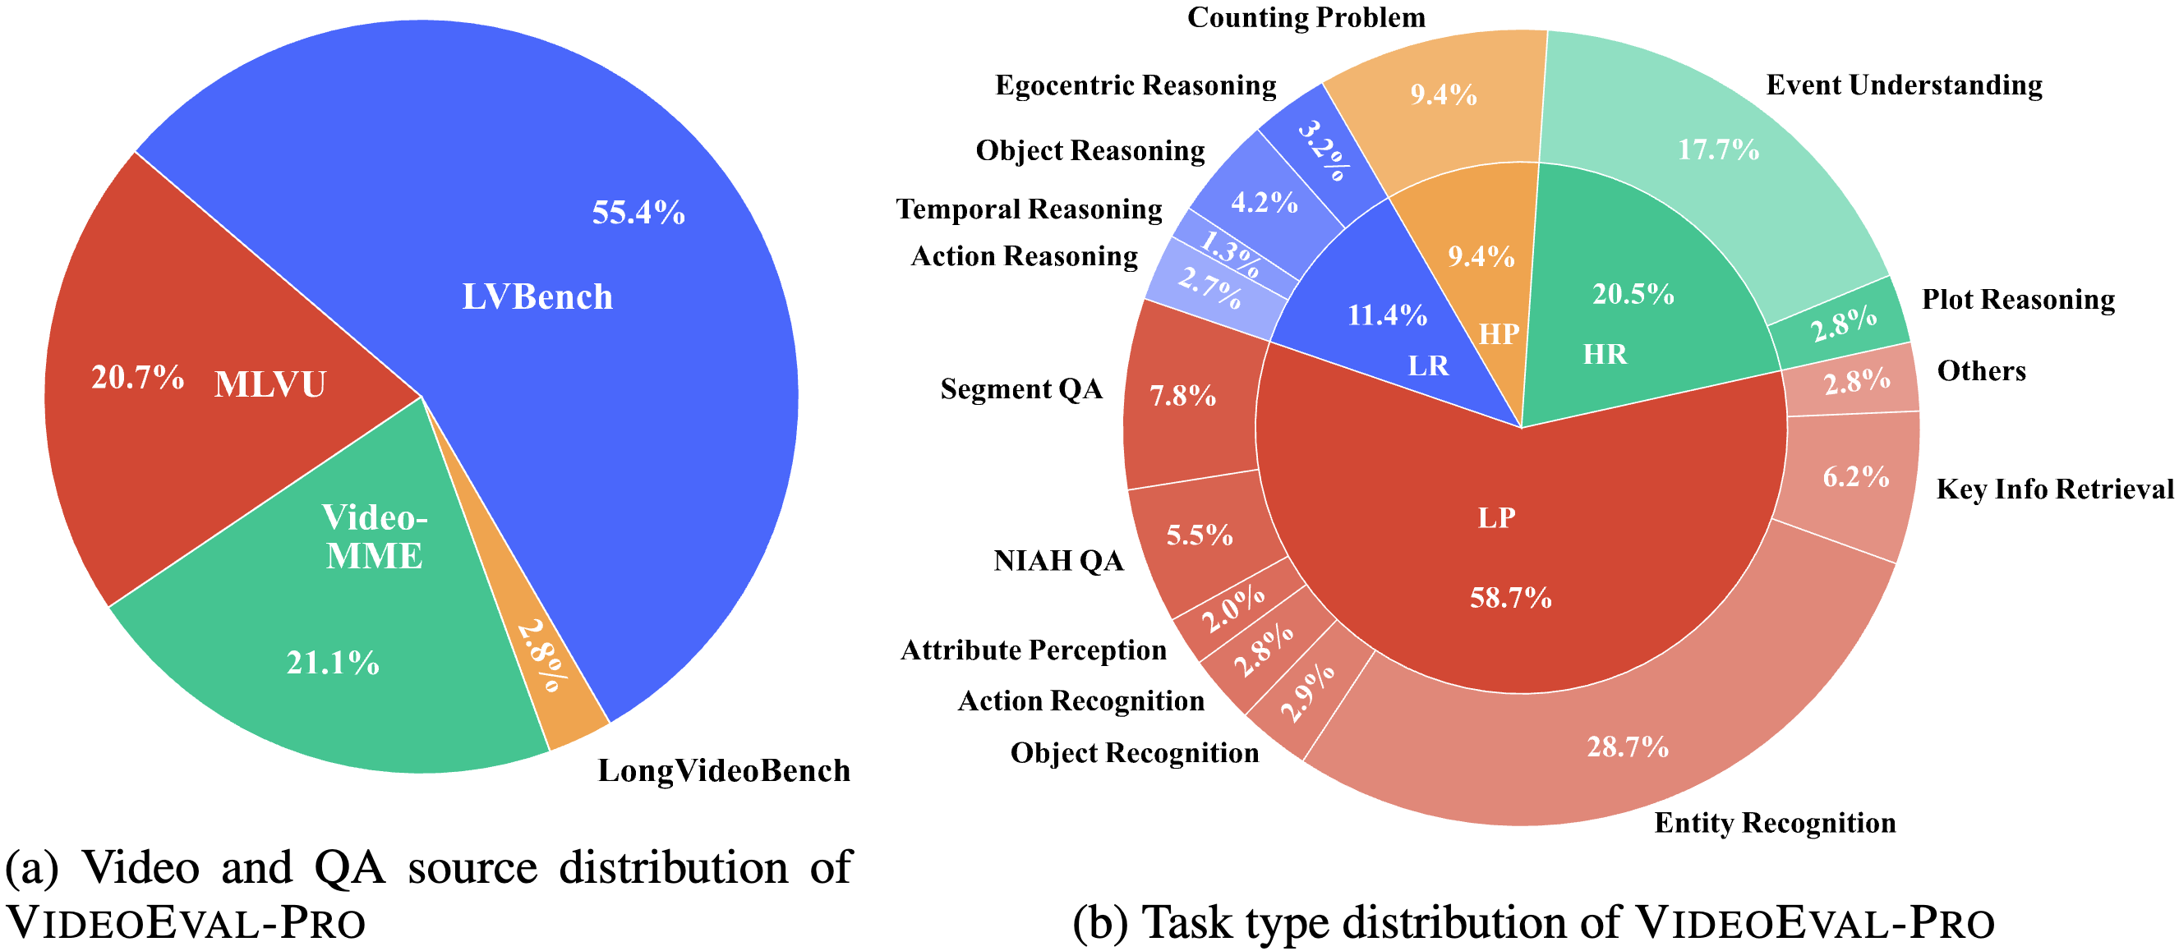
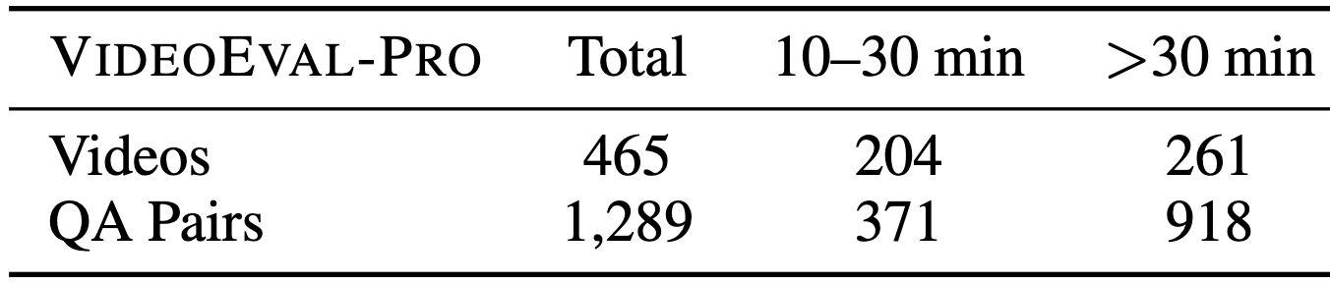
Dataset Composition and Statistics
Data Sources: Video-MME, MLVU, LVBench, LongVideoBench
After data filtering: VideoEval-Pro contains a total of 1,289 questions
Average video duration: 38.3 minutes
Average answer length: 2.1 words

Slide 34
Dataset Composition and Statistics
Task types:
Local Perception (LP)
Local Reasoning (LR)
Holistic Perception (HP)
Holistic Reasoning (HR)

Slide 35
Evaluation on VideoEval-Pro
We include a diverse set of video LMMs
21 models in total
Proprietary models: GPT series and Gemini series
Open-source models: Video-LLaVA, LongVA, QwenVL series, InternVL series, LLaVA-Video, Vamba, etc.
Evaluation Setting:
We evaluate the models using 32, 64, 128, 256, and 512 frames and report the highest accuracy
LLM-as-a-judge for open-ended QA evaluation

Slide 36
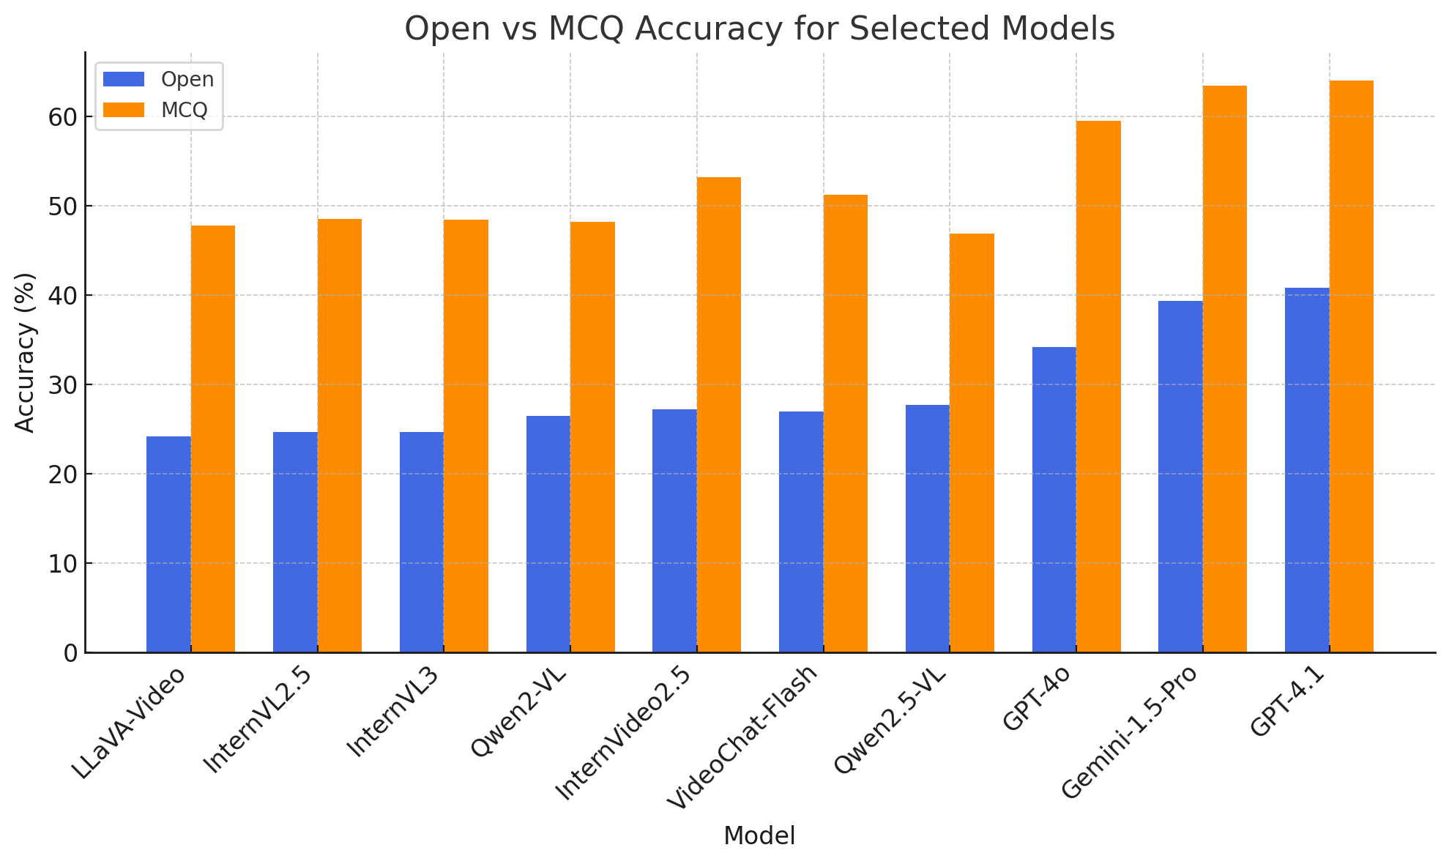
MCQ vs. Open (Ours)

Slide 37

Local vs. Holistic Tasks

Slide 38

Open-source vs. Closed-source

Slide 39

Frame Scaling Properties of VideoEval-Pro
VideoEval-Pro: Steady performance increase with more input frames
Prior Benchmarks: performance saturation/decline as frame increases

Slide 40
Takeaways
Hybrid Mamba-Transformer architectures are highly suitable for long video processing, supporting long video understanding without any token compression.
Hybrid architectures will sacrifice the performance on medium-length video tasks. There is still more work to do.
Video Evaluation should abandon multi-choice questions, which will lead to severe inflation in the performance.
We need to evaluate on more benchmarks to truly understand the progress of video-LLMs.

Slide 41



S4: Recurrent & Convolution
Parallelized Training
A Visual Guide to Mamba and State Space Models. https://newsletter.maartengrootendorst.com/p/a-visual-guide-to-mamba-and-state

